Slide 1
Dynamic Perspective
How a moving camera reveals scene depth and egomotion parameters

Slide 2
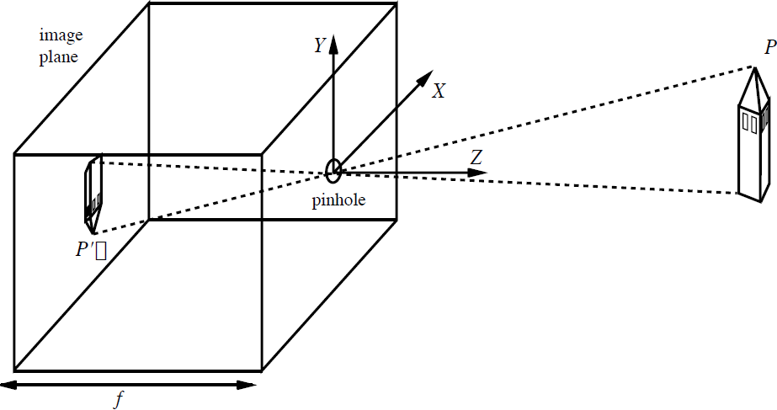


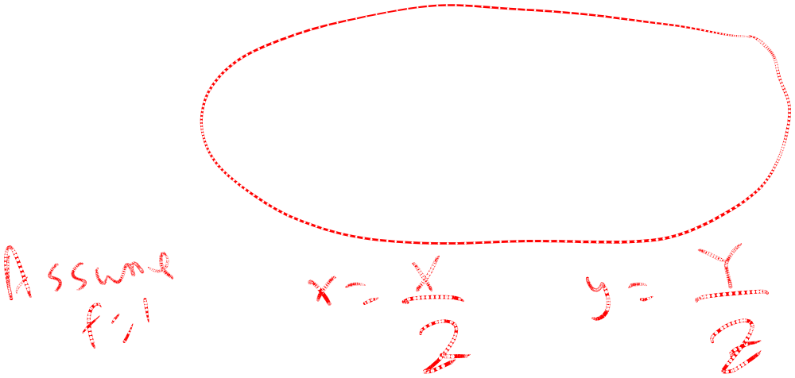

The Pinhole Camera
y
x

Slide 3
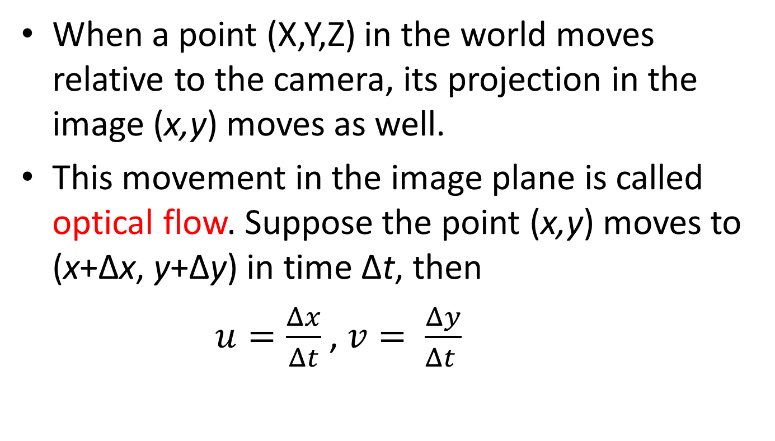
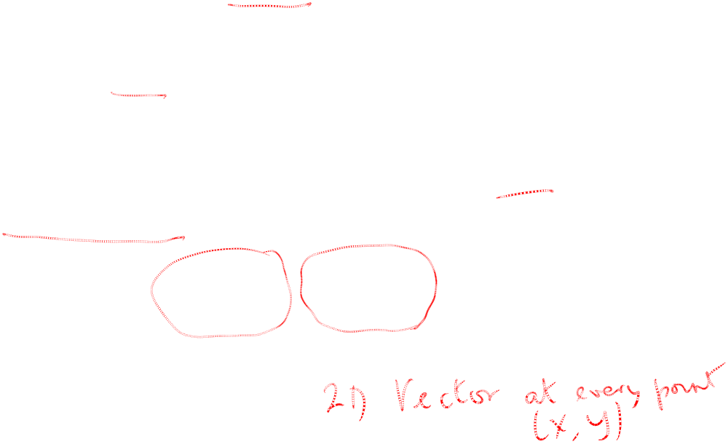
Suppose the camera moves with respect to the world…
are the two components of the optical flow at (x,y)

Slide 4
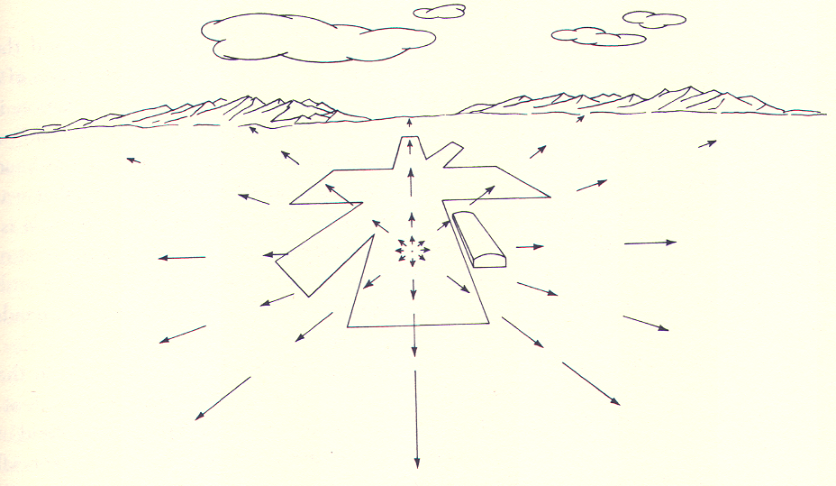
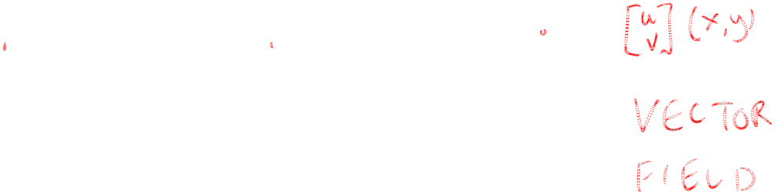
Gibson’s example I:
Optical flow for a pilot landing a plane

Slide 5
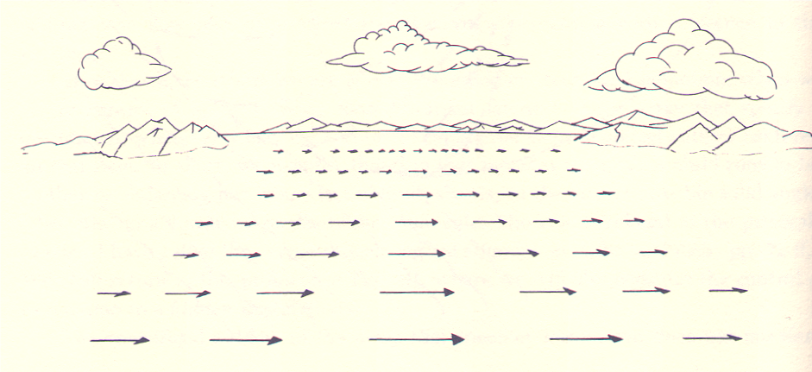
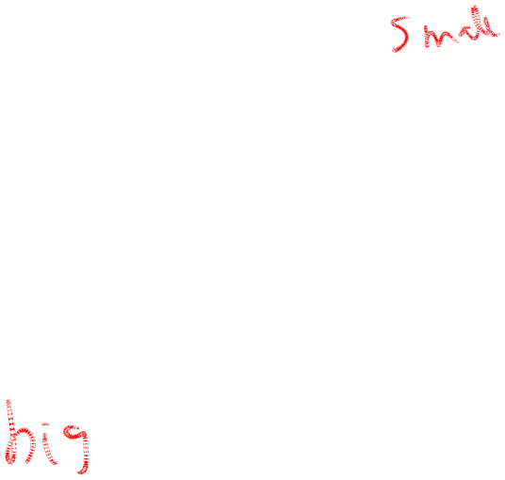
Gibson’s example II:
Optical flow from the side window of a car

Slide 6

Outline
Derive equation relating optical flow field to scene depth Z(x,y) and the motion of the camera t, ω
The translational component of the flow field is the more important one – it is what tells Z(x,y) and the translation t
The rotational component of the flow field reveals information about ω

Slide 7
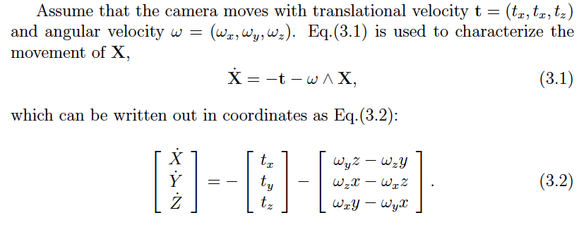
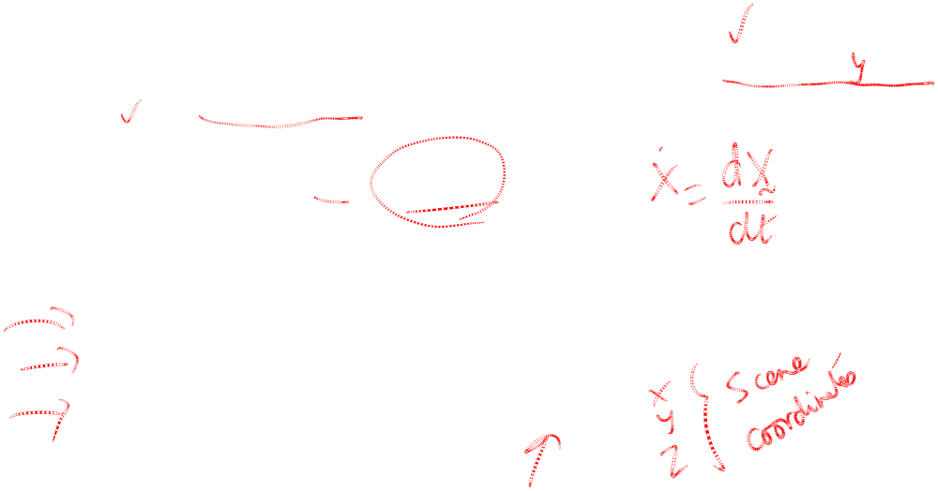
How does a point X in the scene move?

Slide 8
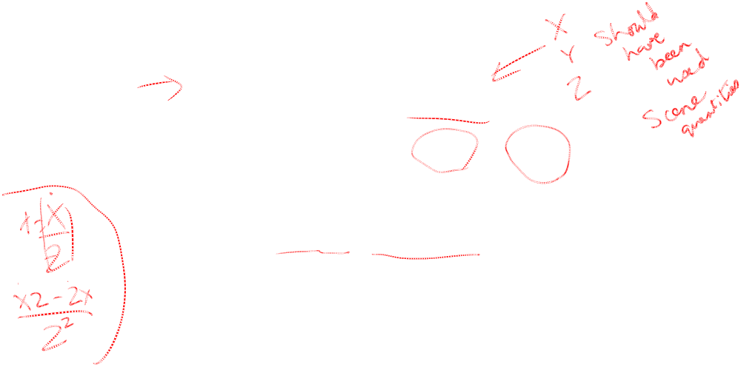
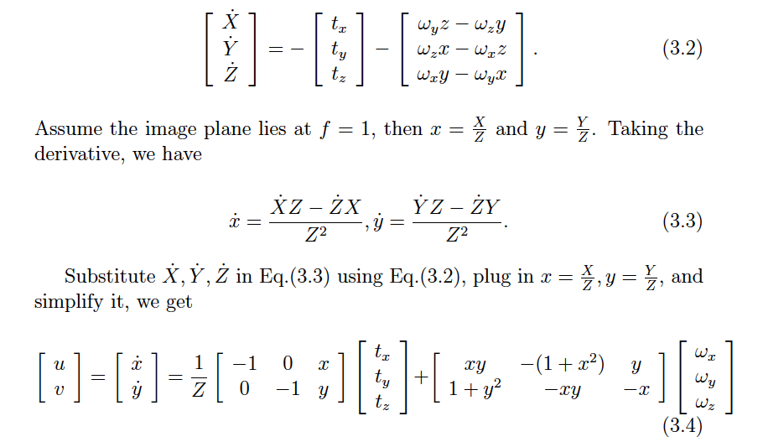
Now consider the effect of projection…

Slide 9

Now consider the effect of projection…

Slide 10
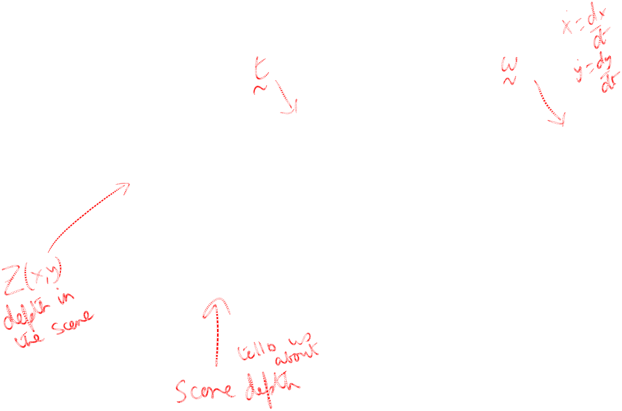
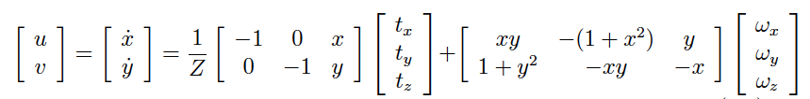




The Optical Flow Equations

